Slide 1
PFAS In Drinking Water: CORRELATIONS TO PFAS In BLOOD SERUM?
Team members:
Dori Bellan (DWQ), Emily Houlihan (DWQ),
Payman Alemi (DDW), Hung Bui (DDW), Rassam Zarghami (DDW), Heidi Dieffenbach (Wood Group, PLC)

Slide 2
The relative contribution of PFAS in drinking water to body load is unknown
Groundwater Quality
Blood Serum
State Water Board 13267 orders for groundwater quality in selective regions in the state
Of the seven PFAS chemicals analyzed in blood serum, 926 records of groundwater quality
CDPH conducted biomonitoring for PFAS in Los Angeles County
In LA County, 425 people were tested for seven PFAS chemicals in their blood serum
All data was scrambled- confidential issues
The goal of this project is to determine if drinking water PFAS levels are correlated measured exposure concentrations

Slide 3
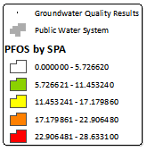

Slide 4
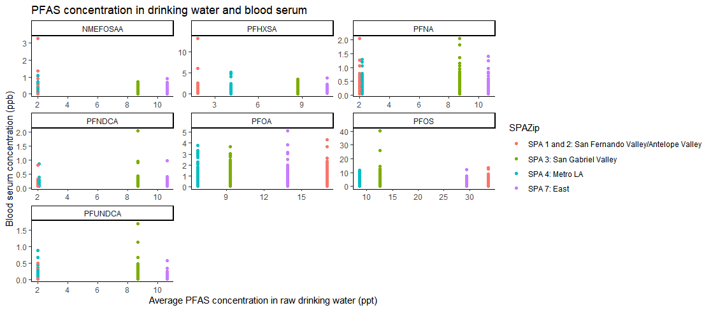

Slide 5
Process
[SUMMARIZE WORKFLOW, I.E. HOW THE PROBLEM WAS ADDRESSED. FLOWCHART MAY BE USEFUL]
December 5, 2019

Slide 6
Results
[SUMMARIZE RESULTS OF PROJECT USING GRAPHICS AND LIMITED TEXT]
December 5, 2019

Slide 7
Summary
[PROBLEM ADDRESSED]
[WAY IT WAS SOLVED]
[FINAL PRODUCT]
[NEXT STEPS]
December 5, 2019

Slide 8
Thank you!
[PROJECT TITLE]
[PROJECT COLLABORATOR NAMES]

